Slide 1

Python For Data Science
Day 2
We will begin shortly.

Slide 2

Raj Krishna Nepal
Data Science Enthusiast Electrical Engineering Pulchowk Campus

Slide 3
Objectives
To Understand Data Visualization
Data Visualization methods and Uses
Matplotlib
Seaborn

Slide 4
Data Visualization
To understand the meaning of data visually
Python provides various data visualization tools
We use matplotlib and seaborn

Slide 5
Need of Data Science
We understand more when we see.
Graphs and plots are easier to understand than the numerical data
So we combine numerical data and visualization to make our ideas heard.

Slide 6
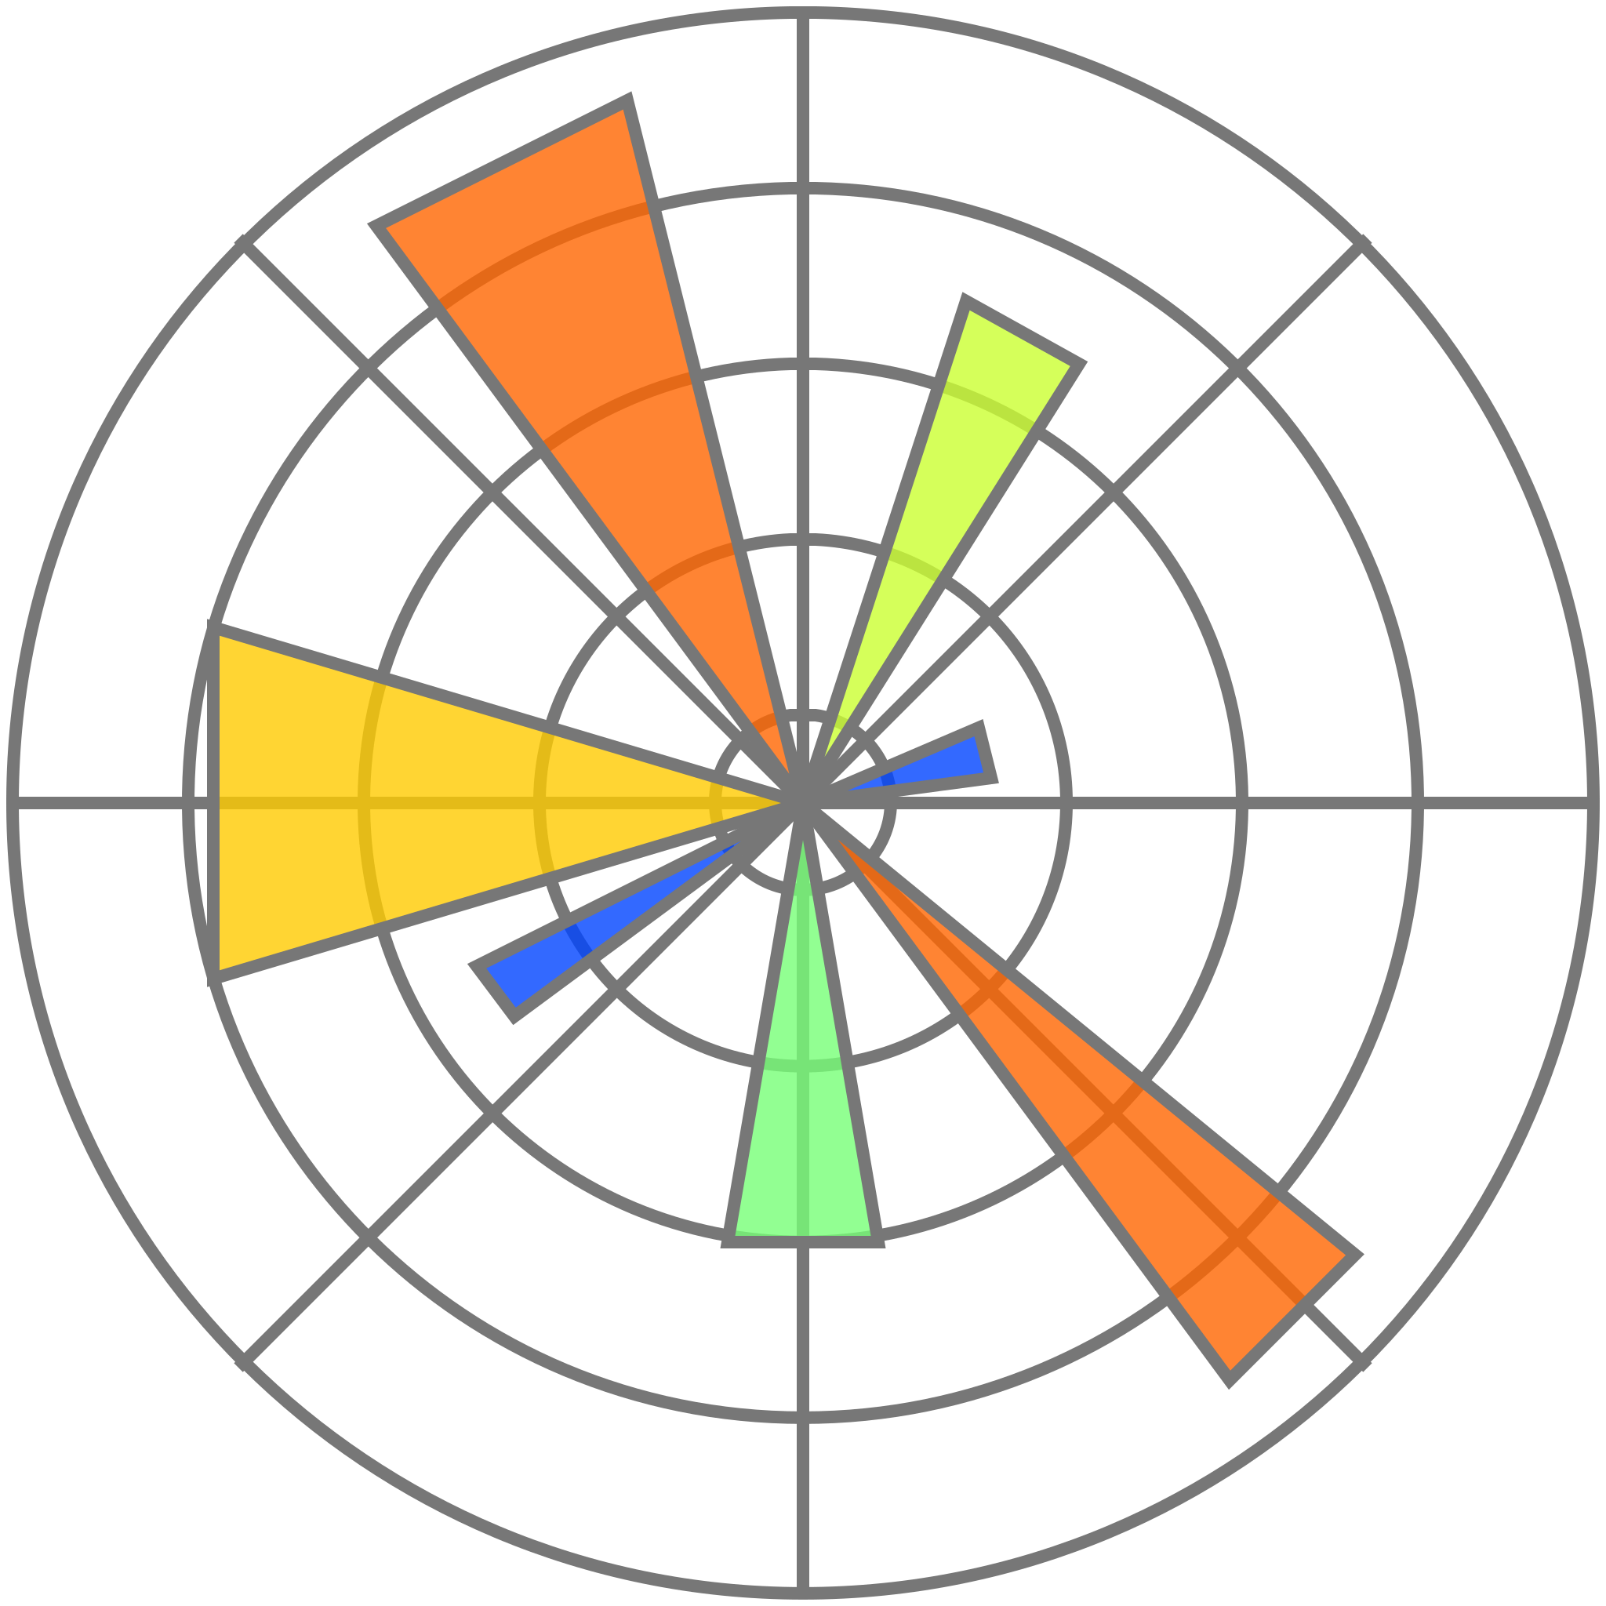
Matplotlib
pip install matplotlib
Already installed in google colab
import matplotlib.pyplot as plt
To draw lines,bar graphs,pie charts and many more

Slide 7
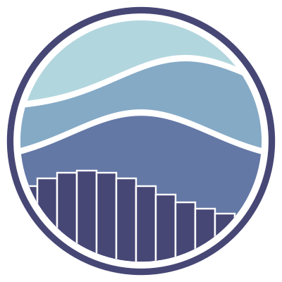
Seaborn
Seaborn is Python visualization library based on Matplotlib.
Visuals that need 20 lines of code using Matplotlib, with seaborn, is reduced by 5-fold

Slide 8
Assignment (Matplotlib):
See the .ipynb file in the same drive.

Slide 9
Assignment (Seaborn):
Same as matplotlib.

Slide 10
THANK YOU!

